Slide 1
COMPILER CONSTRUCTION
Module IV
LR PARSERS
Mr. Roshan Lal
ASET(CSE)

Slide 2
Recommended Reading​
Textbooks: ​
Alfred V. Aho, Monica S. Lam, Ravi Sethi, Jeffrey D. Ullman, “Compilers: Principles Techniques and Tool”, Second Edition, Pearson Publication, 2007.​
​
A.A Putambekar, “Compiler Construction”, Technical Publications, 2009. ​
​
Reference Book: ​
Des Watson, A Practical Approach to Compiler Construction, First Edition, Springer, 2017​

Slide 3
Module Assessment​
Quiz (Conceptual and Numerical Based)
​
Assignment

Slide 4
Syntax directed Translation
As we know that after syntax analysis, semantic analysis of input program is needed.
To perform the semantic analysis in syntax directed fashion, we attach some semantic rules with each production in context free grammar.
Syntax directed translation scheme is a process of allowing semantic actions to be attached to the productions of Context free Grammar.
Two notations are mainly used for associating semantic rules with the productions
Syntax Directed Definition
Translation Scheme

Slide 5
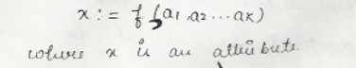
Syntax directed Definition(SDD)
Syntax directed Definition is a generalization of a context free grammar in which each grammar symbol either a terminal or non-terminal has associated set of attributes and each production A-> ά is associated with a set of semantic rules.
An Attribute can be anything like a string, a number, a type or a memory location etc.
The semantic rules are of the form

Slide 6
Syntax directed Definition(SDD)
Attributes are of two types
Inherited Attributes
An Inherited attribute at node N is defined only in terms of attribute values at N’s parent, N itself and N’s siblings.
Eg. A->XYZ { Y.VAL=2*A.VAL}

Slide 7
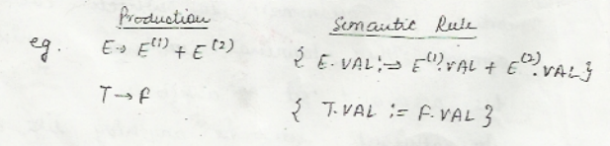
Syntax directed Definition(SDD)
Synthesized Attributes
A synthesized attribute is defined in terms of attribute value at the children node and node itself.
We can say that synthesized attribute can be evaluated during single bottom up traversal of the parse tree.

Slide 8
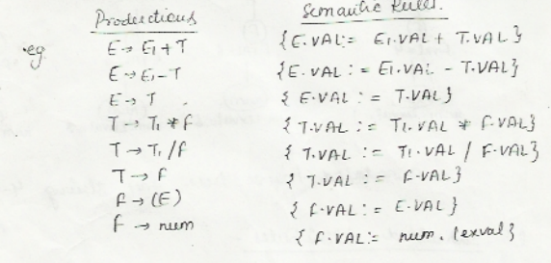
Annotated Parse Tree
A parse tree containing the values of attributes at each of the tree is called annotated parse tree.

Slide 9
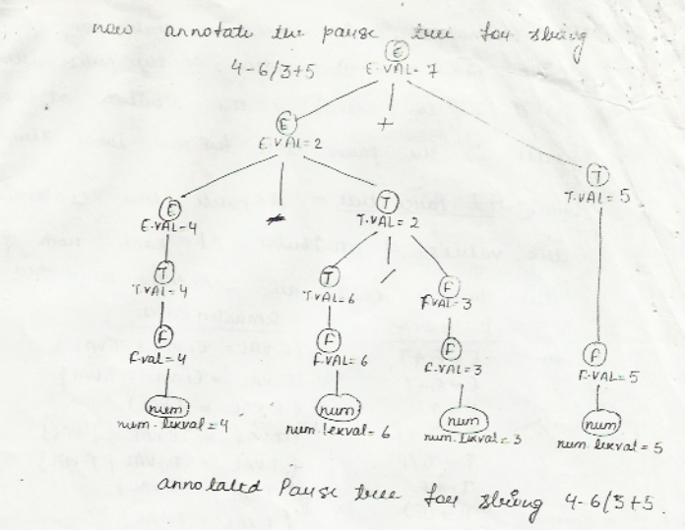
Annotated Parse Tree

Slide 10
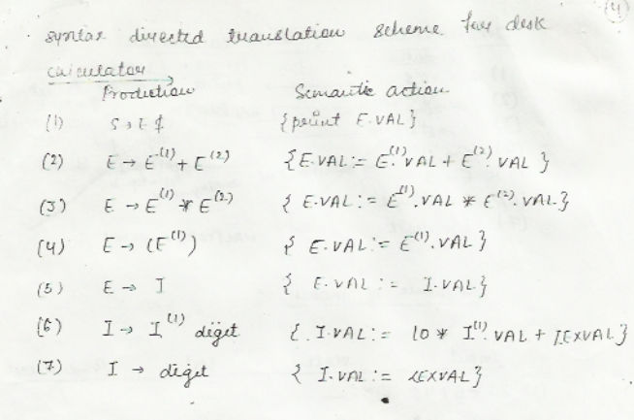
Example:

Slide 11
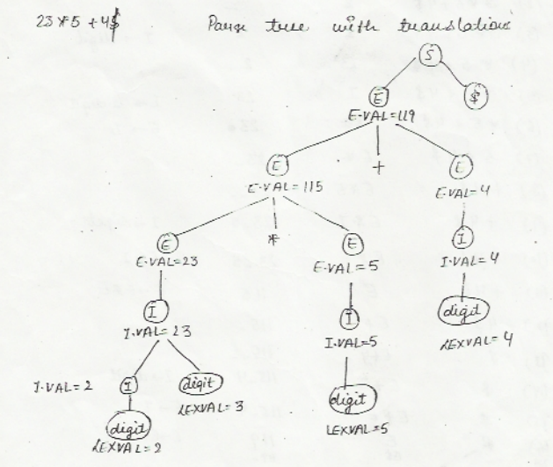
Example:

Slide 12
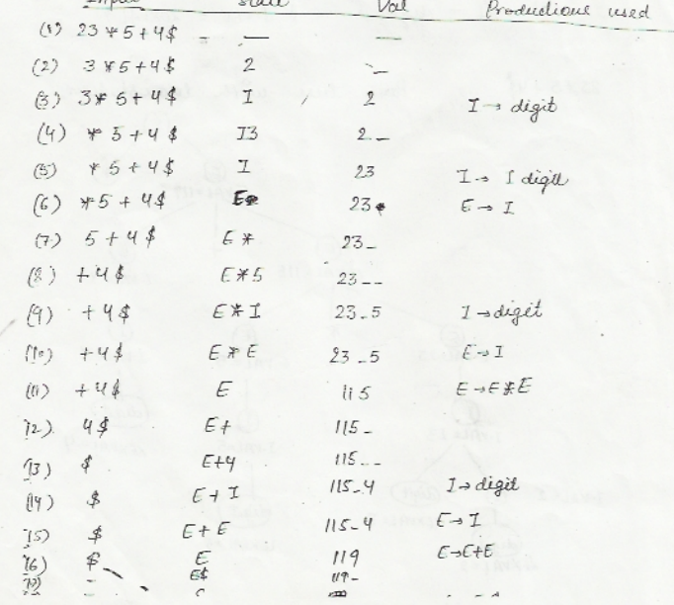
Example:

Slide 13
Example:
Construct Annotated parse tree and also show sequence of moves for the expression (4*7+19)*2$

Slide 14
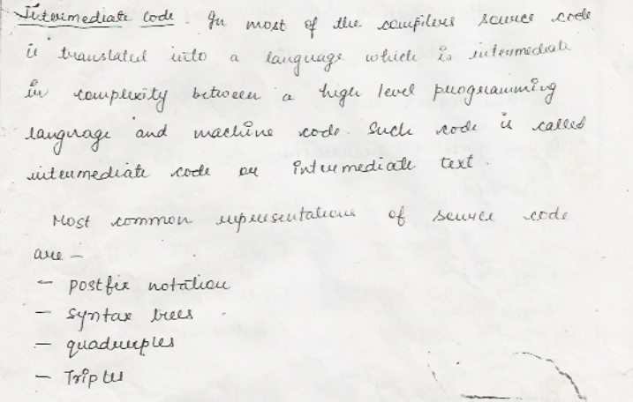
Intermediate Code Generation

Slide 15
INFIX TO POSTFIX ALGORITHM
Read all the symbols one by one from left to right in the given Infix Expression.
Push ‘(‘ onto Stack and ‘)’ at the end of the infix expression.
If the symbol is an operand, then directly add it to final postfix expression(Output).
If the reading symbol is left parenthesis '(', then Push it on to the Stack.
If the reading symbol is right parenthesis ')', then pop all the symbols from the stack until a left parenthesis appears. Discard the left parenthesis and add remaining popped symbols to the postfix expression in the order in which they are popped.
If the reading symbol is an operator (+ , - , * , / etc.,), then Check, if the operator on the top of the stack has higher or equal precedence than the one being read, pop the operator and add it to the postfix expression. Repeat the process until a lower precedence operator appears at the top of the stack. Then push the current operator onto the stack.

Slide 16
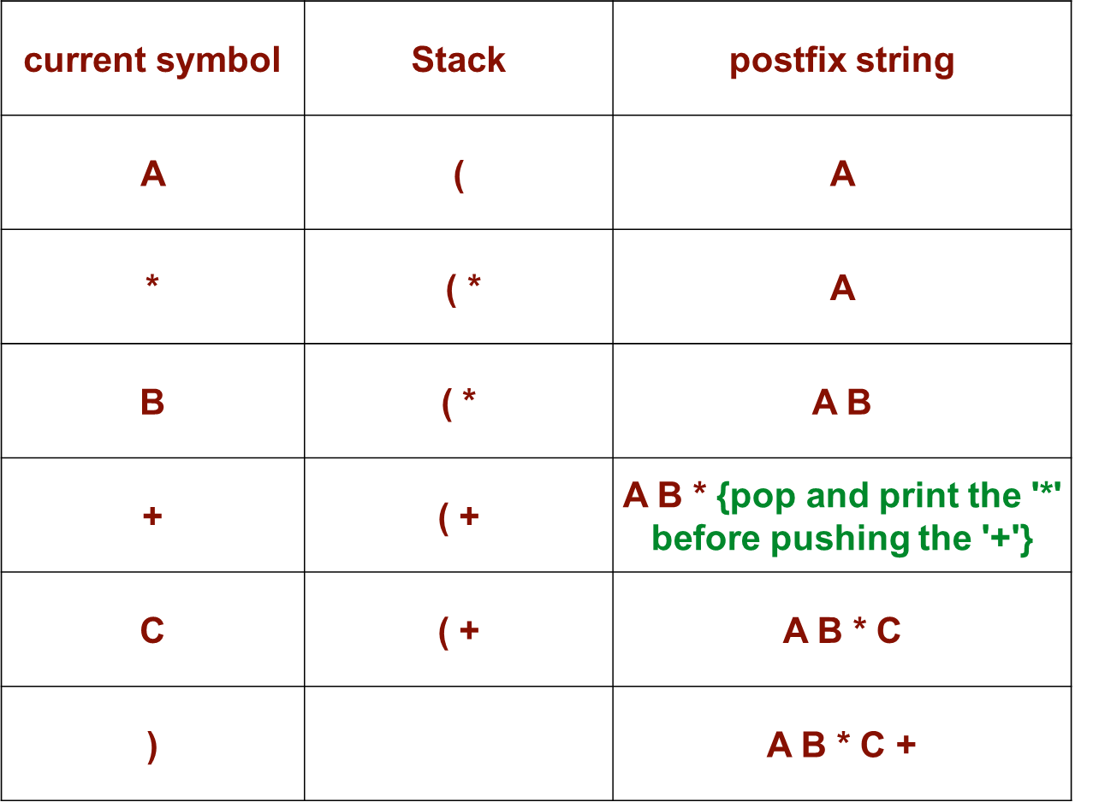
Infix to Postfix
Infix Expression= A*B+C

Slide 17
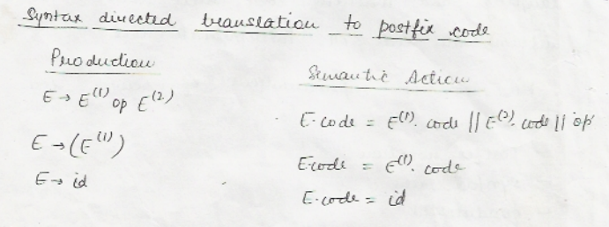
Postfix Notation

Slide 18
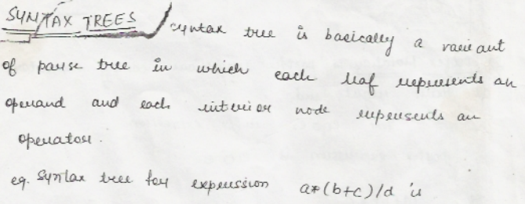
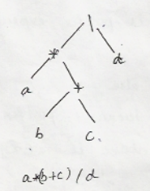
Syntax Tree

Slide 19
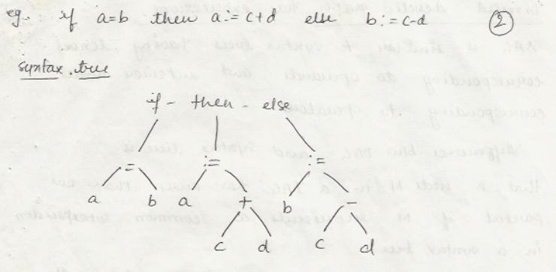
Syntax Tree

Slide 20
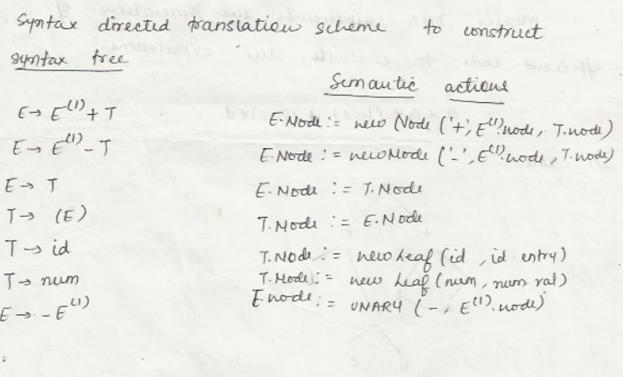
Syntax Tree

Slide 21
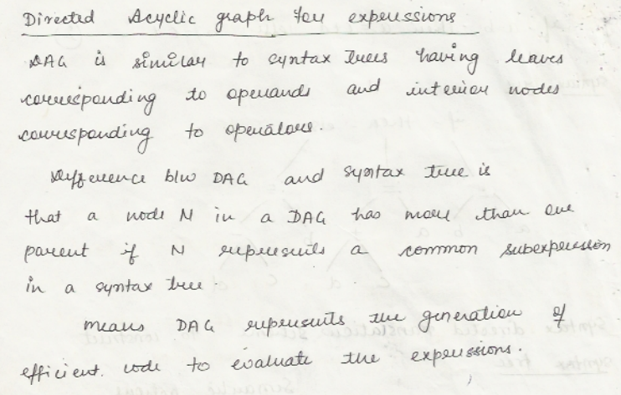
Directed Acyclic Graph(DAG)

Slide 22
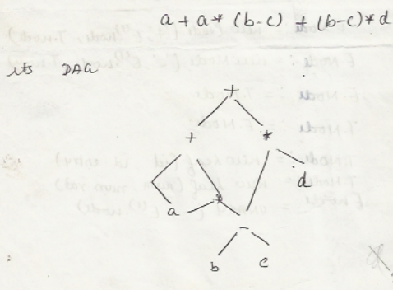
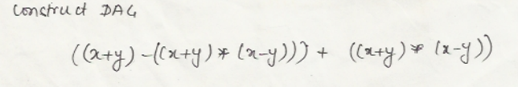
Directed Acyclic Graph(DAG)

Slide 23
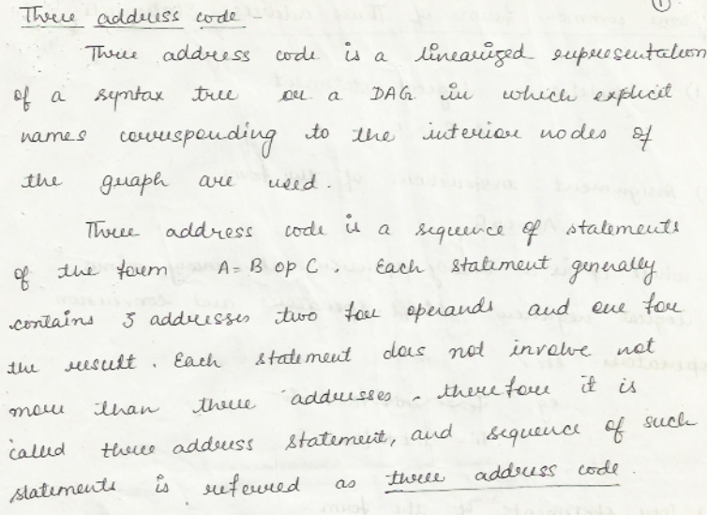
Three Address Code

Slide 24
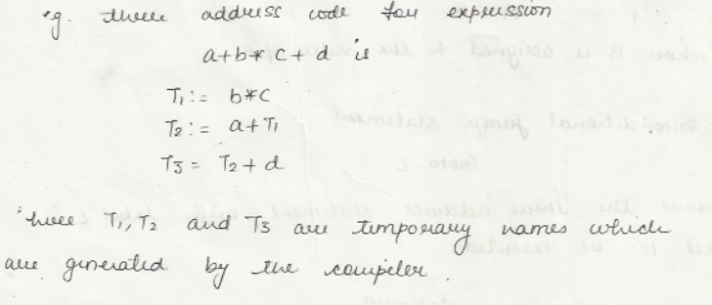
Three Address Code

Slide 25
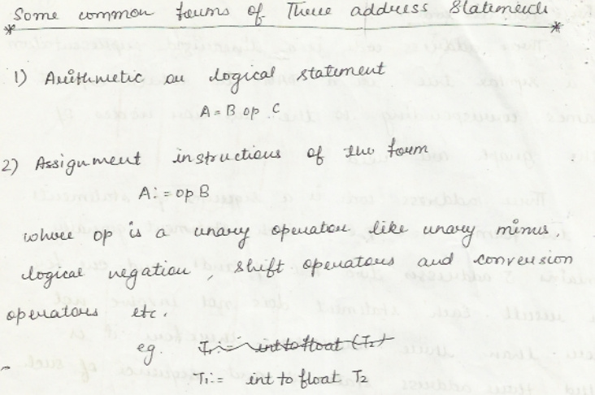
Three Address Code

Slide 26
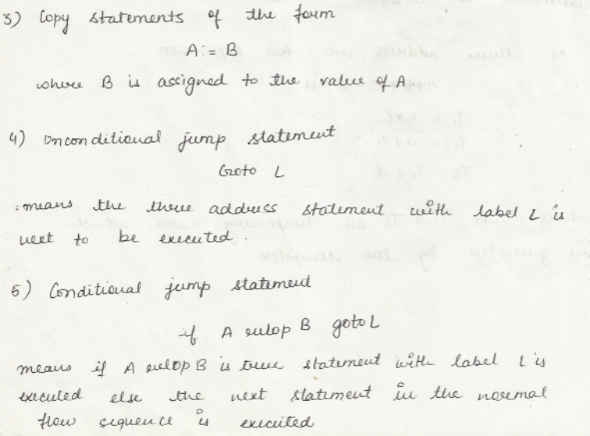
Three Address Code

Slide 27
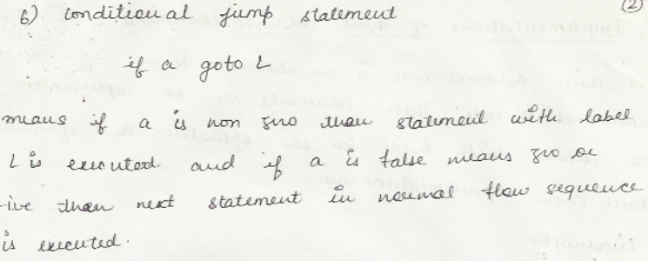
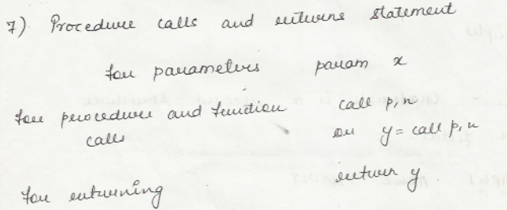
Three Address Code

Slide 28
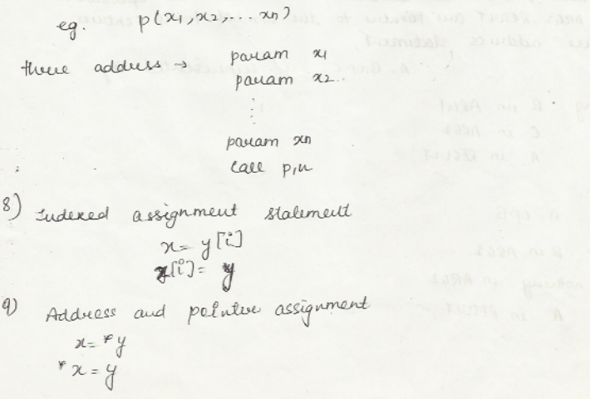
Three Address Code

Slide 29
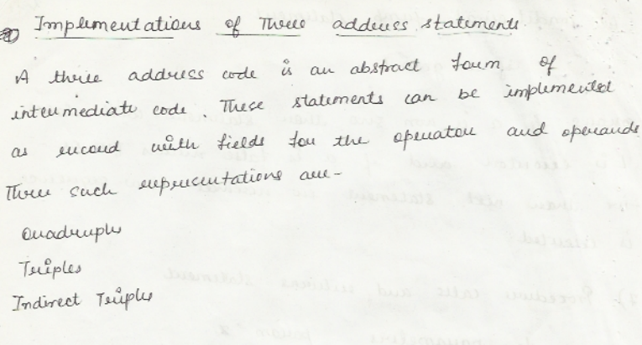
Implementation of Three Address Code

Slide 30
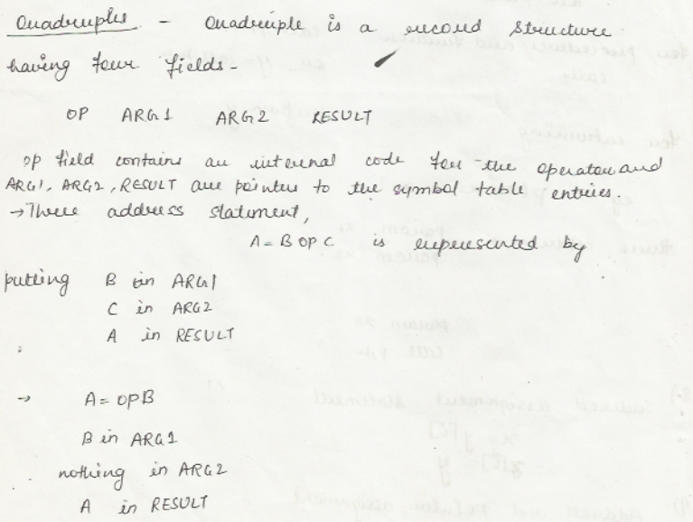
Implementation of Three Address Code

Slide 31
Implementation of Three Address Code

Slide 32
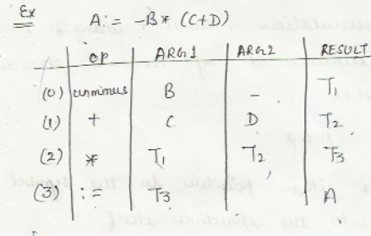
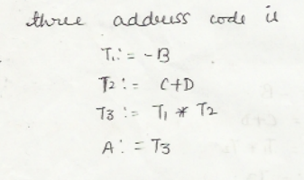
Quadruple

Slide 33
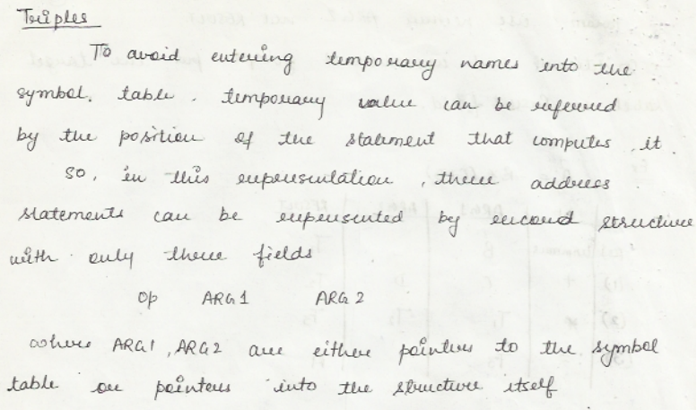
Triples

Slide 34
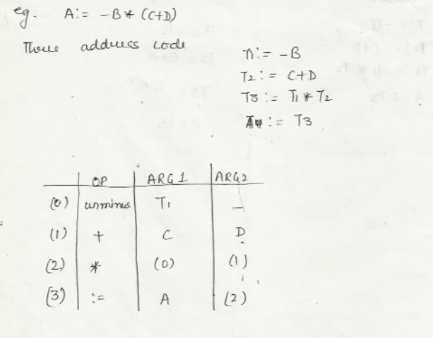
Triples

Slide 35
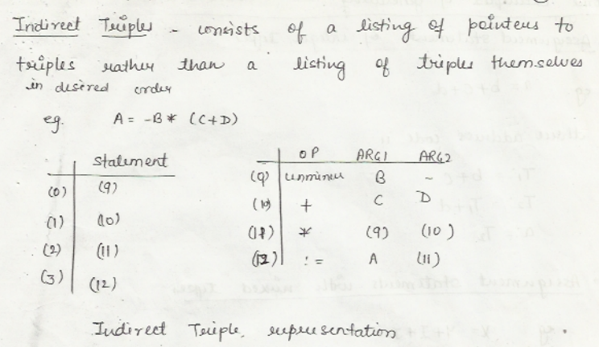
Indirect Triples

Slide 36
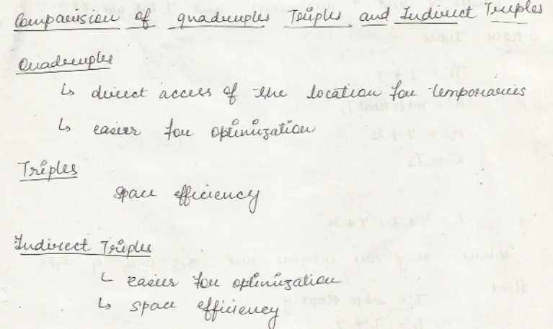

Slide 37
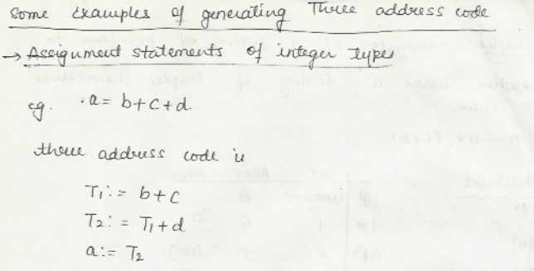
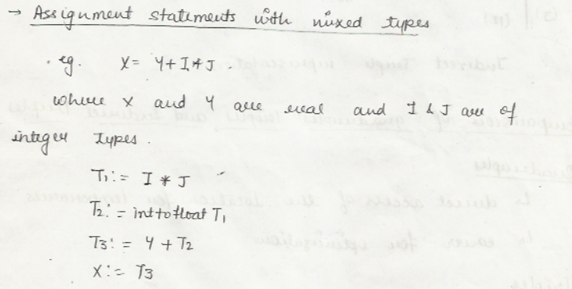

Slide 38
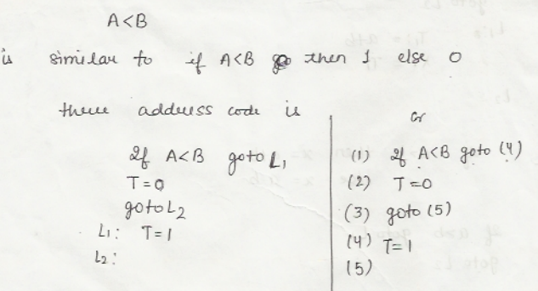
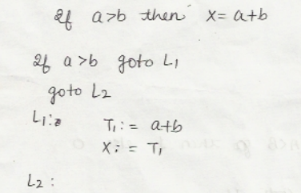

Slide 39
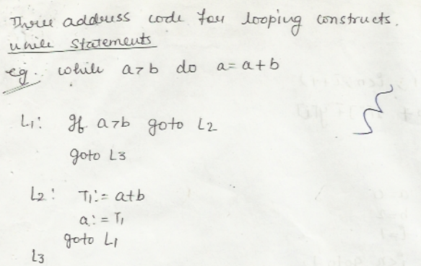
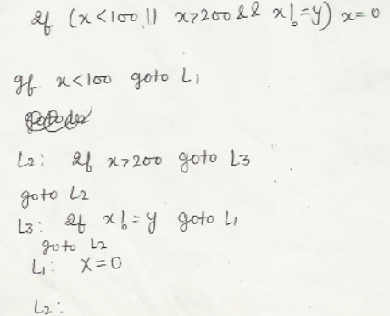

Slide 48


